Slide 1
Wireless Telecommunication Systems
GSM
  Overview
  Services
  Sub-systems
  Components
IS 95
  Overview
  Services
  Sub-systems
  Components
Notes:
Universität Karlsruhe
Institut für Telematik
Mobilkommunikation
SS 1998
Prof. Dr. Dr. h.c. G. Krüger
E. Dorner / Dr. J. Schiller

Slide 2
Mobile phone subscribers worldwide
700000
600000
500000
Analog total
GSM total
400000
CDMA total
subscribers (x 1000)
300000
TDMA total
PDC/PHS total
200000
total
100000
0
1996
1997
1998
1999
2000
2001

Slide 3
GSM: Overview
GSM
  formerly: Groupe Spéciale Mobile (founded 1982)
  now: Global System for Mobile Communication
  Pan-European standard (ETSI, European Telecommunications Standardisation Institute)
  simultaneous introduction of essential digital cellular services in three phases (1991, 1994, 1996) by the European telecommunication administrations, seamless roaming within Europe possible
  today many providers all over the world use GSM (more than 130 countries in Asia, Africa, Europe, Australia, America)
  more than 100 million subscribers

Slide 4
Performance characteristics of GSM
Communication
  mobile, wireless digital communication; support for voice and data services
Total mobility
  international access, chip-card enables use of access points of different providers
Worldwide connectivity
  one number, the network handles localization
High capacity
  better frequency efficiency, smaller cells, more customers per cell
High transmission quality
  high audio quality
  uninterrupted phone calls at higher speeds (e.g., from cars, trains) – better handoffs and
Security functions
  access control, authentication via chip-card and PIN

Slide 5

Disadvantages of GSM
There is no perfect system!!
  no end-to-end encryption of user data
  no full ISDN bandwidth of 64 kbit/s to the user, no transparent B-channel
  abuse of private data possible
    roaming profiles accessible
  high complexity of the system
  several incompatibilities within the GSM standards

Slide 6
GSM: Mobile Services
GSM offers
  several types of connections
    voice connections, data connections, short message service
  multi-service options (combination of basic services)
Three service domains
  Bearer Services – interface to the physical medium (transparent for example in the case of voice or non transparent for data services)
  Telematic Services – services provided by the system to the end user (e.g., voice, SMS, fax, etc.)
  Supplementary Services – associated with the tele services: call forwarding, redirection, etc.
bearer services
MS
GSM-PLMN
transit
network
(PSTN, ISDN)
source/
destination
network
TE
MT
TE
R, S
U_{m}
(U, S, R)
tele services

Slide 7

Bearer Services
Telecommunication services to transfer data between access points
  R and S interfaces – interfaces that provide network independent data transmission from end device to mobile termination point.
  U interface – provides the interface to the network (TDMS, FDMA, etc.)
Specification of services up to the terminal interface (OSI layers 1-3)
  Transparent – no error control of flow control, only FEC
  Non transparent – error control, flow control
Different data rates for voice and data (original standard)
  voice service (circuit switched)
    synchronous: 2.4, 4.8 or 9.6 Kbps.
  data service (circuit switched)
    synchronous: 2.4, 4.8 or 9.6 kbit/s
    asynchronous: 300 - 1200 bit/s
  data service (packet switched)
    synchronous: 2.4, 4.8 or 9.6 kbit/s
    asynchronous: 300 - 9600 bit/s

Slide 8
Tele Services I
Telecommunication services that enable voice communication via mobile phones
All these basic services have to obey cellular functions, security measures etc.
Offered voice related services
  mobile telephony
  primary goal of GSM was to enable mobile telephony offering the traditional bandwidth of 3.1 kHz
  Emergency number
  common number throughout Europe (112); mandatory for all service providers; free of charge; connection with the highest priority (preemption of other connections possible)
  Multinumbering
  several ISDN phone numbers per user possible

Slide 9
Tele Services II
Additional services: Non-Voice-Teleservices
  group 3 fax
  voice mailbox (implemented in the fixed network supporting the mobile terminals)
  electronic mail (MHS, Message Handling System, implemented in the fixed network)
  ...
  Short Message Service (SMS)
  alphanumeric data transmission to/from the mobile terminal using the signaling channel, thus allowing simultaneous use of basic services and SMS (160 characters)

Slide 10
Supplementary services
Services in addition to the basic services, cannot be offered stand-alone
May differ between different service providers, countries and protocol versions
Important services
  identification: forwarding of caller number
  suppression of number forwarding
  automatic call-back
  conferencing with up to 7 participants
  locking of the mobile terminal (incoming or outgoing calls)
  ...

Slide 11
Architecture of the GSM system
GSM is a PLMN (Public Land Mobile Network)
  several providers setup mobile networks following the GSM standard within each country
  components
    MS (mobile station)
    BS (base station)
    MSC (mobile switching center)
    LR (location register)
  subsystems
    RSS (radio subsystem): covers all radio aspects
    NSS (network and switching subsystem): call forwarding, handover, switching
    OSS (operation subsystem): management of the network

Slide 12
GSM: overview
OMC, EIR,
AUC
HLR
fixed network
GMSC
NSS
with OSS
VLR
MSC
VLR
MSC
BSC
BSC
RSS

Slide 13
GSM: elements and interfaces
radio cell
MS
MS
BSS
U_{m}
radio cell
RSS
BTS
MS
BTS
A_{bis}
BSC
BSC
A
MSC
MSC
NSS
VLR
VLR
signaling
HLR
GMSC
ISDN, PSTN
IWF
PDN
O
OSS
EIR
AUC
OMC

Slide 14
GSM: system architecture
radio
subsystem
network and switching subsystem
fixed
partner networks
MS
MS
ISDN
PSTN
U_{m}
MSC
BTS
A_{bis}
BSC
EIR
BTS
SS7
HLR
BTS
VLR
BSC
ISDN
PSTN
BTS
A
MSC
BSS
IWF
PSPDN
CSPDN

Slide 15
System architecture: radio subsystem
radio
subsystem
network and switching
subsystem
MS
MS
Components
  MS (Mobile Station)
  BSS (Base Station Subsystem):
  consisting of
    BTS (Base Transceiver Station):
    sender and receiver
    BSC (Base Station Controller):
    controlling several transceivers
Interfaces
  U_{m} : radio interface
  A_{bis} : standardized, open interface with
  16 kbit/s user channels
  A: standardized, open interface with
  64 kbit/s user channels
U_{m}
BTS
A_{bis}
BSC
MSC
BTS
A
BTS
MSC
BSC
BTS
BSS

Slide 16
System architecture: network and switching subsystem
network
subsystem
fixed partner
networks
Components
  MSC (Mobile Services Switching Center):
  IWF (Interworking Functions)
  ISDN (Integrated Services Digital Network)
  PSTN (Public Switched Telephone Network)
  PSPDN (Packet Switched Public Data Net.)
  CSPDN (Circuit Switched Public Data Net.)
Databases
  HLR (Home Location Register)
  VLR (Visitor Location Register)
  EIR (Equipment Identity Register)
ISDN
PSTN
MSC
EIR
SS7
HLR
VLR
ISDN
PSTN
MSC
IWF
PSPDN
CSPDN

Slide 17
Radio subsystem
The Radio Subsystem (RSS) comprises the cellular mobile network up to the switching centers
Components
  Base Station Subsystem (BSS):
    Base Transceiver Station (BTS): radio components including sender, receiver, antenna - if directed antennas are used one BTS can cover several cells
    Base Station Controller (BSC): switching between BTSs, controlling BTSs, managing of network resources, mapping of radio channels (U_{m}) onto terrestrial channels (A interface)
    BSS = BSC + sum(BTS) + interconnection
  Mobile Stations (MS)

Slide 18
GSM: cellular network
segmentation of the area into cells
possible radio coverage of the cell
idealized shape of the cell
cell
  use of several carrier frequencies
  not the same frequency in adjoining cells
  cell sizes vary from some 100 m up to 35 km depending on user density, geography, transceiver power etc.
  hexagonal shape of cells is idealized (cells overlap, shapes depend on geography)
  if a mobile user changes cells
  ⬇ handover of the connection to the neighbor cell

Slide 19
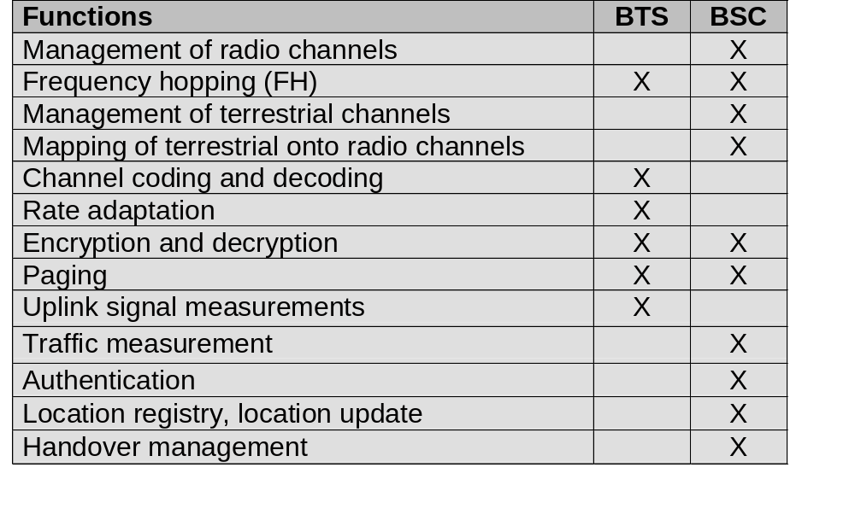
Base Transceiver Station and Base Station Controller
Tasks of a BSS are distributed over BSC and BTS
BTS comprises radio specific functions
BSC is the switching center for radio channels

Slide 20
Mobile station
Terminal for the use of GSM services
A mobile station (MS) comprises several functional groups
  MT (Mobile Terminal):
    offers common functions used by all services the MS offers
    corresponds to the network termination (NT) of an ISDN access
    end-point of the radio interface (U_{m})
  TA (Terminal Adapter):
    terminal adaptation, hides radio specific characteristics (TE connects via modem, Bluetooth, IrDA etc. to MT)
  TE (Terminal Equipment):
    peripheral device of the MS, offers services to a user
    Can be a headset, microphone, etc.
    does not contain GSM specific functions
  SIM (Subscriber Identity Module):
    personalization of the mobile terminal, stores user parameters
TE
TA
MT
R
S
U_{m}

Slide 21
Network and switching subsystem
NSS is the main component of the public mobile network GSM
  switching, mobility management, interconnection to other networks, system control
Components
  Mobile Services Switching Center (MSC)
  controls all connections via a separated network to/from a mobile terminal within the domain of the MSC - several BSC can belong to a MSC
  Databases (important: scalability, high capacity, low delay)
    Home Location Register (HLR)
    central master database containing user data, permanent and semi-permanent data of all subscribers assigned to the HLR (one provider can have several HLRs)
    Visitor Location Register (VLR)
    local database for a subset of user data - data about all users currently visiting in the domain of the VLR

Slide 22
Mobile Services Switching Center
The MSC (mobile switching center) plays a central role in GSM
  switching functions
  additional functions for mobility support
  management of network resources
  interworking functions via Gateway MSC (GMSC)
  integration of several databases
Functions of a MSC
  specific functions for paging and call forwarding
  termination of SS7 (signaling system no. 7)
  mobility specific signaling
  location registration and forwarding of location information
  provision of new services (fax, data calls)
  support of short message service (SMS)
  generation and forwarding of accounting and billing information

Slide 23
Operation subsystem
The OSS (Operation Subsystem) enables centralized operation, management, and maintenance of all GSM subsystems
Components
  Authentication Center (AUC)
    generates user specific authentication parameters on request of a VLR
    authentication parameters used for authentication of mobile terminals and encryption of user data on the air interface within the GSM system
  Equipment Identity Register (EIR)
    registers GSM mobile stations and user rights
    stolen or malfunctioning mobile stations can be locked and sometimes even localized
  Operation and Maintenance Center (OMC)
    different control capabilities for the radio subsystem and the network subsystem

Slide 24
GSM Radio Interface - TDMA/FDMA
935-960 MHz
124 channels (200 kHz)
downlink
frequency
890-915 MHz
124 channels (200 kHz)
uplink
higher GSM frame structures
time
GSM TDMA frame
1
2
3
4
5
6
7
8
4.615 ms
GSM time-slot (normal burst)
guard
space
guard
space
tail
user data
S
Training
S
user data
tail
3 bits
57 bits
1
26 bits
1
57 bits
3
546.5 µs
577 µs

Slide 25
GSM hierarchy of frames
hyperframe
0
1
2
...
2045
2046
2047
3 h 28 min 53.76 s
superframe
0
1
2
...
48
49
50
6.12 s
0
1
...
24
25
multiframe
0
1
...
24
25
120 ms
0
1
2
...
48
49
50
235.4 ms
frame
0
1
...
6
7
4.615 ms
slot
burst
577 µs

Slide 26
GSM protocol layers for signaling
U_{m}
A_{bis}
A
MS
BTS
BSC
MSC
CM
CM
MM
MM
RR
RR’
BTSM
BSSAP
BSSAP
RR’
BTSM
SS7
SS7
LAPD_{m}
LAPD_{m}
LAPD
LAPD
radio
radio
PCM
PCM
PCM
PCM
16/64 kbit/s
64 kbit/s /
2.048 Mbit/s

Slide 27

Mobile Terminated Call
1: calling a GSM subscriber
2: forwarding call to GMSC
3: signal call setup to HLR
4, 5: request MSRN from VLR
6: forward responsible
MSC to GMSC
7: forward call to
current MSC
8, 9: get current status of MS
10, 11: paging of MS
12, 13: MS answers
14, 15: security checks
16, 17: set up connection
4
HLR
VLR
5
8
9
3
6
14
15
calling
station
7
PSTN
GMSC
MSC
1
2
10
10
13
10
16
BSS
BSS
BSS
11
11
11
11
12
17
MS

Slide 28
Mobile Originated Call
1, 2: connection request
3, 4: security check
5-8: check resources (free circuit)
9-10: set up call
VLR
3
4
6
5
PSTN
GMSC
MSC
7
8
2
9
1
MS
BSS
10

Slide 29
MTC/MOC
MS
MTC
BTS
MS
MOC
BTS
paging request
channel request
channel request
immediate assignment
immediate assignment
paging response
service request
authentication request
authentication request
authentication response
authentication response
ciphering command
ciphering command
ciphering complete
ciphering complete
setup
setup
call confirmed
call confirmed
assignment command
assignment command
assignment complete
assignment complete
alerting
alerting
connect
connect
connect acknowledge
connect acknowledge
data/speech exchange
data/speech exchange

Slide 30
Handoffs
GSM uses mobile assisted hand-off (MAHO). Signal strength measurements are sent to the BS from the mobile.
The MSC decides when to do a handoff and it informs the new BS and the mobile.
When a mobile switches to a new BS it sends a series of shortened bursts to adjust its timing (giving the bS time to calculate it and send it) and allow the new BS to synchronize its receiver to the arrival time of the messages

Slide 31
4 types of handover
1
2
3
4
MS
MS
MS
MS
BTS
BTS
BTS
BTS
BSC
BSC
BSC
MSC
MSC

Slide 32
Handover decision
receive level
BTS_{old}
receive level
BTS_{old}
HO_MARGIN
MS
MS
BTS_{old}
BTS_{new}

Slide 33
Handover procedure
MS
BTS_{old}
BSC_{old}
MSC
BSC_{new}
BTS_{new}
measurement
report
measurement
result
HO decision
HO required
HO request
resource allocation
ch. activation
HO request ack
ch. activation ack
HO command
HO command
HO command
HO access
Link establishment
HO complete
HO complete
clear command
clear command
clear complete
clear complete

Slide 34
Security in GSM
Security services
  access control/authentication
    user  SIM (Subscriber Identity Module): secret PIN (personal identification number)
    SIM  network: challenge response method
  confidentiality
    voice and signaling encrypted on the wireless link (after successful authentication)
  anonymity
    temporary identity TMSI
    (Temporary Mobile Subscriber Identity)
    newly assigned at each new location update (LUP)
    encrypted transmission
3 algorithms specified in GSM
  A3 for authentication (“secret”, open interface)
  A5 for encryption (standardized)
  A8 for key generation (“secret”, open interface)
“secret”:
A3 and A8 available via the Internet
network providers can use stronger mechanisms

Slide 35
GSM - authentication
mobile network
SIM
RAND
K_{i}
RAND
RAND
K_{i}
AC
128 bit
128 bit
128 bit
128 bit
A3
A3
SIM
SRES* 32 bit
SRES 32 bit
MSC
SRES* =? SRES
SRES
32 bit
SRES
K_{i}: individual subscriber authentication key SRES: signed response

Slide 36
GSM - key generation and encryption
mobile network (BTS)
MS with SIM
RAND
K_{i}
RAND
RAND
K_{i}
AC
128 bit
128 bit
128 bit
128 bit
SIM
A8
A8
cipher
key
K_{c}
64 bit
K_{c}
64 bit
data
encrypted
data
SRES
BTS
data
MS
A5
A5

Slide 37
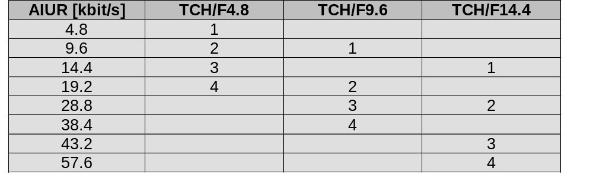
Data services in GSM I
Data transmission standardized with only 9.6 kbit/s
  advanced coding allows 14.4 kbit/s
  not enough for Internet and multimedia applications
HSCSD (High-Speed Circuit Switched Data)
  already standardized
  bundling of several time-slots to get higher
  AIUR (Air Interface User Rate)
  (e.g., 57.6 kbit/s using 4 slots, 14.4 each)
  advantage: ready to use, constant quality, simple
  disadvantage: channels blocked for voice transmission

Slide 38
Data services in GSM II
GPRS (General Packet Radio Service)
  packet switching
  using free slots only if data packets ready to send
  (e.g., 115 kbit/s using 8 slots temporarily)
  standardization 1998
  advantage: one step towards UMTS, more flexible
  disadvantage: more investment needed
GPRS network elements
  GSN (GPRS Support Nodes): GGSN and SGSN
  GGSN (Gateway GSN)
    interworking unit between GPRS and PDN (Packet Data Network)
  SGSN (Serving GSN)
    supports the MS (location, billing, security)
  GR (GPRS Register)
    user addresses

Slide 39
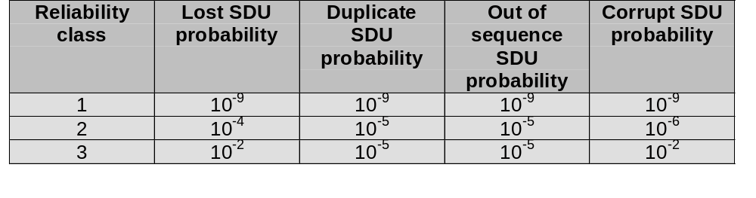
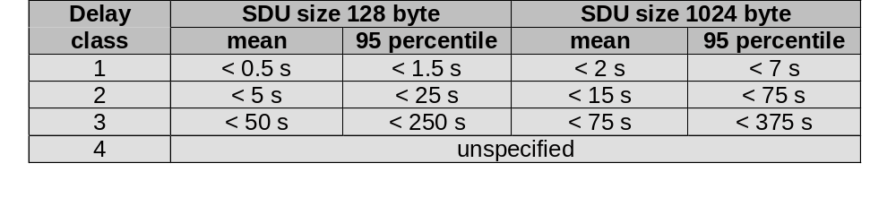
GPRS quality of service

Slide 40
GPRS architecture and interfaces
SGSN
G_{n}
MS
BSS
SGSN
GGSN
PDN
U_{m}
G_{b}
G_{n}
G_{i}
HLR/
GR
MSC
VLR
EIR

Slide 41
GPRS protocol architecture
MS
U_{m}
BSS
G_{b}
SGSN
G_{n}
GGSN
G_{i}
apps.
IP/X.25
IP/X.25
SNDCP
SNDCP
GTP
GTP
LLC
LLC
UDP/TCP
UDP/TCP
RLC
RLC
BSSGP
BSSGP
IP
IP
MAC
MAC
FR
FR
L1/L2
L1/L2
radio
radio

Slide 42
IS 95
The existing 12.5 MHz cellular bands are used to derive 10 different CDMA bands (1.25MHz per band).
The frequency reuse factor in CDMA is 1. The channel rate is 1.2288Mbps (actually chips not bits!).
Multipath fading is exploited in CDMA. It provides for space (path) diversity, RAKE receivers are used to combine the output of several received signals. Ofcourse fading does still occur on the individual signals but each signal is affected differently and so using several of them to make a decision improves the probability of obtaining a correct decision. This is referred to as multipath diversity combining.
  The rake receiver at the mobile uses three correlators to receive three different signals that are spaced more than (>) .8micro secs (1 chip width) away. Signals spaced less than (<) .8microsecs cause interference and signals spaced exactly .8microsecs away will cause a maximum fade. A fourth receiver is used as a roving finger, it is used to detect new strong incoming signals. This process ensures that the RAKE receiver always uses the 3 strongest signals. At the BS all four correlators are used to receive signals (note BS use antenna diversity).

Slide 43
IS 95: Coding and Modulation
64 bit Walsh codes (proving 64 bit orthogonal codes) are used to provide 64 channels within each frequency band. They are used for spreading in the downlink. In the uplink it is used to provide orthogonal modulation but not spreading to the full 1.2288 rate.
Besides the Walsh codes, 2 other codes are used in IS-95:
  Long PN code:generated from a 42 bit shift register having 2⁴²-1=4.398 x 10¹² different codes. A mask is used to overlay the codes, the mask differs from channel to channel.The chip rate is 1.2288Mcps. These codes are used for:
    Data scrambling/encryption in the downlink
    Data spreading and encryption in the up link
  Short PN code: generated from a pair of 15 bit shift registers having 2¹⁵ - 1 = 32,767 codes. These codes are used for synchronization in the down and up links and cell identification in the down link (each cell uses one of 512 possible offsets, adjacent cells must use different offsets). The chip rate is 1.2288Mcps (i.e., not used for spreading!)

Slide 44
IS 95: The Channels
The forward and reverse links are separated by 45MHz.
The downlink comprises the following logical channels:
  Pilot channel (always uses Walsh code W0)
  Paging channel(s) (use Walsh codes W1 - W7)
  Sync channel (always uses Walsh code W32)
  Traffic channels ( use Walsh codes W8 - W31 and W33 - W63)
The uplink comprises the following logical channels:
  Access channel
  Traffic channel

Slide 45
IS 95: Link Protocols
The link protocol can be summarised as follows:
  Mobile acquires phase, timing, and signal strength via the pilot channel.
  Mobile synchronizes via the sync channel.
  Mobile gets system parameters via the paging channel.
  Mobile and BS communicate over the traffic channels during a connection.
  Mobile and BS communicate over the access and paging channels during system acquisition and paging.

Slide 46
IS 95: The different codes and their use
The forward (downlink) channels and reverse (uplink) channels use different spreading and scrambling processes.
  The forward channels are spread using one of 64 orthogonal Walsh functions. This provides perfect separation between the channels (in the absence of multpath!). Then, to reduce interference between mobiles that use the same Walsh function in neighboring cells, all signals in a particular cell are scrambled using the short PN sequence (cell identification) in the radio modulator. For the paging and the traffic channels, the long PN sequence is used to scramble the signal before spreading. It can also be used for encryption on the traffic channel if the mask instead of being the ESN of the mobile is a private long code exchanged during the authentication procedure.
  The reverse channels are spread using the long PN sequence. All 64 orthogonal Walsh functions are used to provide orthogonal modulation. The stream is then scrambled using the short PN sequence for cell identification purposes.

Slide 47
IS 95: Power Control I
It is of paramount importance for a CDMA system.
In order to have max. efficiency, the power received at the BS from all the mobiles must be nearly equal.
If a terminal’s power is too low, then many bit errors will occur.
If a terminal’s power is too high , the level of interference will go up.
Closed loop power control at the terminals: power control information is sent to the terminal from the BS . Puncturing is used, 2 data symbols are replaced by one power control symbol (double the power). This bit either indicates a transition up or a transition down in power in 1db increments. The power bit is sent 16 times per 20ms frame (every 1.25ms)! (P_{closed})

Slide 48
IS 95: Power Control II
Open loop power control at the terminals:. The mobile senses the strength of the pilot signal and can adjust its power based upon that. If signal is very strong, the assumption can be made that the mobile is very close to BS and the power should be dropped. The mobile uses P_{target} sent in the access param. msg.(P_{open})
The transmitted power at the terminal in units of dBm is: P_{tran}=P_{open}+P_{closed}
Open loop power control at the BS: the BS decreases its power level gradually and waits to hear from the mobile what the frame error rate (FER) is (power measurement report). If high then it increases its power level.

Slide 49
IS 95: Handoffs I
CDMA supports two types of handoffs:
  hard handoff
  soft handoff
  A hard handoff is a break before make scenario, where prob. of
  dropping a call is higher. A soft handoff is a make before break
  scenario.
The mobile assists in the handoff process and therefore it is referred to as Mobile Assisted Hand Off (MAHO). It reports signal measurements to the BS. The roving finger (or searcher) of the RAKE receiver is used to measure the pilot signals of neighboring BSs (neighbor list messages sent to terminals periodically). During call set-up a mobile is given a list of handoff thresholds and a list of likely new cells. The mobile keeps track of those cells that fall above the threshold and sends this information to the MSC.

Slide 50
IS 95: Handoffs II
The mobile and the MSC classify the neighboring BSs to keep track of the handoff process (based upon data received from the mobile, the MSC constantly re-classifies BSs with regard to the mobile):
  active list: contains BSs currently used for communication (contains at least one BS)
  candidate list: contains list of BSs that could be used for communication based upon current signal strength measurements
  neighbor list: contains a list of BSs that could soon be promoted to candidate list
  remaining list: all other BSs that do not qualify
The MSC, when it moves a BS from the candidate list into the active list, will direct that BS to serve the terminal. It informs both the new BS and the mobile and assigns a forward channel number (Walsh code) for communication (on condition there is one available!).

Slide 51
IS 95: Handoffs III
Soft handoffs consist of the mobile being served by two BSs. That means that:
  A mobile receives the signal from two BSs simultaneously. That is possible because an MS always receives 4 signals (RAKE receiver - one correlator is used to receive the signal from a different BS)
  The signal from the mobile is received by two BSs. This is possible as a CDMA channel simply consists of a transmission by the mobile using its ESN to identify itself on the reverse channel and only requires a correlator at the BS to be used to receive the signal.
Soft handoffs also eliminate the ping pong effect (i.e., when traveling along the boundary of two cells and switching back and forth between two BSs). The mobile is being served by two BSs and does not have to switch BSs until absolutely necessary!
The handoff process is also unique in that the mobile initiates the hand off. The MS analyze the measurements and inform the MSC when a handoff might be necessary. (If one BS’s signal strength becomes much higher than the other).

Slide 52
IS 95: Handoffs IV
The handoff process is controlled by the MSC. When a handoff finally occurs all three MS correlators are switched over to the new cell and used as a RAKE receiver again, the connection to the current BS is cutoff and the new BS becomes the current BS.
In summary: the handoff process is executed in three steps:
  mobile is in communication with original (i.e., current) BS.
  mobile is in communication with both the current cell and the new cell.
  mobile is in communication with the new cell only (which becomes the current cell).

